Slide 1
Hepatitis–B Risk Modelling
Project By:
Hong Chen
Moiyyad Sufi

Slide 2
Motivation
Hepatitis B is a viral infection that attacks the liver and can cause both acute and chronic disease
The virus is most commonly transmitted during birth or through contact with body fluids
Can cause a chronic infection and puts people at high risk of death from cirrhosis and liver cancer.
2, 3, or 4 shots of Hepatitis B vaccine at young age gives lifelong immunity. Anyone 59 years of age or younger who has not yet gotten the vaccine should be vaccinated.
Sources:[1] WHO : https://www.who.int/news-room/fact-sheets/detail/hepatitis-b#:~:text=Hepatitis%20B%20is%20a%20viral,a%20mother%20to%20her%20baby.
[2] CDC: https://www.cdc.gov/vaccines/hcp/vis/vis-statements/hep-b.html#:~:text=Child's%20First%20Vaccines-,Why%20get%20vaccinated?,feel%20or%20look%20sick%20themselves.

Slide 3
Methodology
Build a Machine Learning model trained on NHANES 2017 to 2018 data to predict Hepatitis B infection risk to diagnose the most vulnerable patients for current Hep B infection ASAP
Process:
Collect patient data in a clinical setting including Age, Gender Race, Income, Immunity, Country of Birth, Vaccination Status, Foreign Country Travel, Blood Transfusion History
Input patient data to the model
Output is value from 0 to 1 representing Hepatitis B infection risk with 0 representing low risk and 1 as high risk

Slide 4
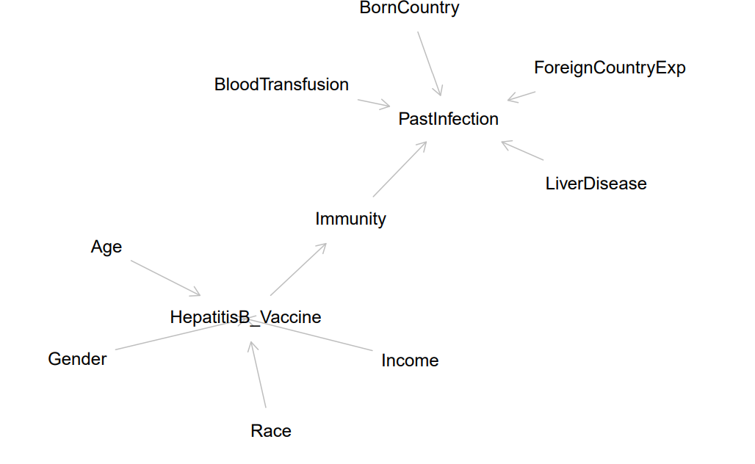
Model Assumptions

Slide 5
Model Details
Two-step modelling is done as follows:
Predict Hepatitis B Vaccination Status
- Vaccination Status, if missing, is predicted using Income, Race, Gender, Age as variables
Vaccination is used to calculate Immunity Status of the patient.
2. Predict Infection Risk
- Infection Risk is predicted using Immunity Status, Foreign Country Travel, Country of Birth, Past Liver Disease and Blood Transfusion status

